Slide 1
IBM University Engagement Project Submission
“Exploring the Power of Agentic AI with IBM Granite and LangFlow”

Slide 2
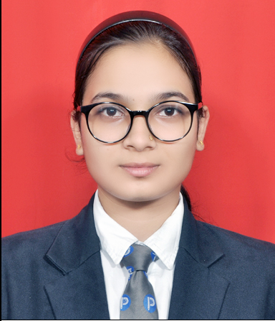
Project Tile – Study genie! – Intelligent Study Mentor using Agentic AI and RAG
Domain of Project – Education
Student Name | Recent Passport Photo | Email ID | Mobile number [WhatsApp]
Tanisha Sameer Pathan |  | tanishapathan04@gmail.com | +919156821175

Slide 3
Problem Statement -
Problem Statement : Study genie!
The Challenge
Students often struggle to manage multiple study materials spread across PDFs, lecture notes, books, and presentations. Finding accurate information quickly is time-consuming, and generic AI assistants may provide answers that are not aligned with a student's own study resources. This results in inefficient learning and poor exam preparation.
The Objective
Build an AI-powered Study Mentor that:
Provides personalized learning support.
Retrieves answers from uploaded study material using RAG.
Generates summaries, quizzes, flashcards, and revision notes.
Creates personalized study plans.
Assists students in understanding difficult concepts.

Slide 4
Proposed Solution -
Proposed Solution: AI-Powered Study Genie!
Study Genie AI is an AI-powered educational assistant developed using IBM watsonx Orchestrate and IBM Granite models.
The system combines Retrieval-Augmented Generation (RAG) with conversational AI to provide personalized educational support.
The solution allows students to upload lecture notes, textbooks, and study materials. When a student asks a question, the AI retrieves the most relevant content from the uploaded documents before generating an accurate response.
The system helps students by:
Explaining difficult concepts.
Generating summaries.
Creating quizzes.
Preparing flashcards.
Building personalized study schedules.
Supporting exam preparation.

Slide 5
Technology Used
Technology | Purpose
IBM Cloud | Hosting platform
IBM watsonx Orchestrate | AI Agent Development
IBM Granite Model | Natural Language Understanding
Retrieval-Augmented Generation (RAG) | Accurate document retrieval
Knowledge Base | Uploaded PDFs
Prompt Engineering | AI behavior customization

Slide 6
Langflow component Used -
1.Chat Input
Students ask educational questions.
2.IBM Granite Model
Processes user queries using natural language.
3.Knowledge Base
Retrieves relevant content from uploaded PDFs.
4.RAG Engine
Combines retrieved information with AI reasoning.
5.Chat Output
Returns accurate, structured educational responses.

Slide 7
Langflow workflow -
Student
↓
Upload PDFs
↓
Knowledge Base (RAG)
↓
IBM watsonx Orchestrate
↓
IBM Granite Model
↓
Personalized AI Response

Slide 8
Architecture blueprint
Student
│
▼
Chat Interface
│
▼
IBM watsonx Orchestrate
↙ ↘
Knowledge Base Granite LLM
↘ ↙
AI Response
│
▼
Student

Slide 9

Role of Agentic AI in the solution
Role of Agentic AI in Study Genie Agent
Study Genie AI uses Agentic AI to provide intelligent educational assistance.
The AI agent:
Understands student questions.
Retrieves relevant information from uploaded study materials.
Generates personalized explanations.
Creates quizzes and revision notes.
Builds study plans.
Supports continuous learning.
Instead of acting like a traditional chatbot, the agent performs multiple educational tasks autonomously to improve learning outcomes.
.

Slide 10
Personalized learning experience
Retrieval-Augmented Generation (RAG)
AI-powered study planning
Intelligent quiz generation
Flashcard generation
Works directly with student notes
Built on IBM Granite Models
Simple conversational interface
Faster revision
Accurate document-based responses
Novelty and Uniqueness

Slide 11
Git Hub Link
https://github.com/tanishapathan-jpg/StudyGenie-AI
·
·
·

Slide 12
Future Scope
Voice-based learning assistant
Mobile application
Multi-language support
Learning analytics dashboard
AI-powered exam prediction
Student progress tracking
Integration with LMS platforms
Personalized career guidance
.
·
·
·

Slide 13
Certificates Earned:

Slide 15
Certificates Earned:​
Add your IBM BOB Certificate

Slide 18


